Slide 1
The Ultimate Persistent To-Do List
Presented By : Kaartick Kannadasan R

Slide 2
Abstract
This project is a robust, single-page To-Do List application built using HTML, CSS, and JavaScript. Its primary function is to allow users to effectively manage tasks by adding, completing, and deleting items. The core technical achievement is data persistence, ensuring that all tasks are automatically saved and reloaded, even after the browser is closed or refreshed, by leveraging the browser's Local Storage feature. The application demonstrates proficiency in front-end development, event handling, and data storage.

Slide 3
Existing system
The existing system refers to simple, introductory To-Do List models found in basic tutorials.
Lack of Persistence: The major drawback is that they rely only on active browser memory.
Data Loss: All tasks created by the user are lost instantly when the browser tab is closed or the page is refreshed.
Limited Utility: They serve only as temporary scratchpads and have no practical, real-world utility for long-term task management.

Slide 4
Proposed system
The proposed system enhances the existing model by integrating data persistence using the JavaScript Local Storage API.
Automatic Saving: The application automatically saves the complete state of the task list (including text and completion status) immediately after any change (add, delete, or mark complete).
Automatic Loading: It features a loadTasks() function that retrieves the saved data every time the application starts.
Enhanced User Experience: This transforms the app from a temporary demo into a functionally persistent and reliable task manager.

Slide 5
advantages
Focus on the benefits derived from using Local Storage.
Zero Data Loss: Tasks are saved across sessions, providing reliability.
Instant Load Time: Data is retrieved from the user's local machine, meaning the list loads instantly without waiting for an external server.
No Backend Dependency: The application is purely client-side; it does not require a database or a server to manage user data, making it lightweight and cheap to host.
Intuitive UX: Marking tasks complete with a strikethrough and easy deletion makes the interface highly user-friendly.

Slide 6
disadvantages
Browser-Specific: Data is stored only on the specific browser and device used. The list cannot be synchronized across a user's phone and desktop.
Storage Limit: Local Storage has a small data limit (typically 5-10MB), which is fine for a To-Do List but unsuitable for large applications.
Security: Local Storage is not recommended for storing sensitive personal information, though it is acceptable for simple task text.

Slide 7
Hardware and software requirements
Hardware Requirements
Processor: Any modern CPU (Intel i3/equivalent or higher).
RAM: 4 GB RAM (Minimum) / 8 GB RAM (Recommended).
Storage: Minimal storage required for the code files.
Software Requirements
Operating System: Windows, macOS, or Linux.
Code Editor: Visual Studio Code (VS Code) is recommended for development.
Browser: Any modern web browser (Chrome, Firefox, Edge, Safari) to run the application.

Slide 8
Modules and description
Module Description
Task Management : Handles the core CRUD (Create, Read, Update, Delete) operations, including the addTask() function and the event listeners for deletion and completion toggling.
Element Creation (createTaskElement) : This is the rendering module. It dynamically generates the HTML <li> element for a new task and attaches the necessary event handlers.
Data Persistence : Manages saving and loading the task array using Local Storage. It converts the JavaScript object data into a storable JSON string and back.

Slide 9
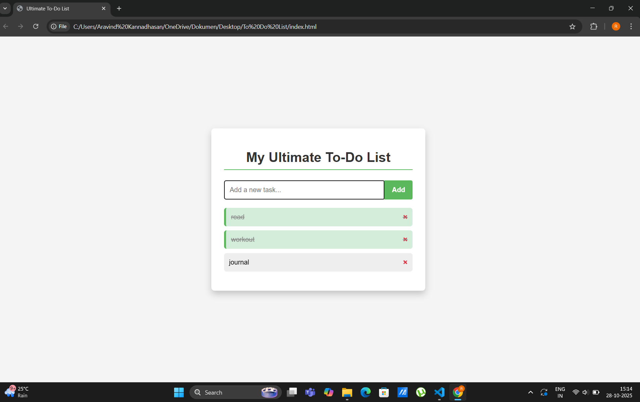
Sample output

Slide 10
conclusion
The Ultimate To-Do List project successfully implemented a persistent, user-friendly task management system using client-side technologies. The primary objective of enabling zero data loss was achieved through the effective utilization of the browser's Local Storage API. The project not only demonstrates fundamental web development skills but also provides a practical and useful utility, ready for further scaling or synchronization features in the future.

Slide 11
Thank you

